Slide 1
Stat 390 Presentation #2
Health Informaticians
Dila Bitlis, Walker Frisbie, Lucinda Hu, Julia Nelson, & Kayla Terrelonge

Slide 2
Objectives
Expand biomedical knowledge of C-MIL, especially classification systems & staining
Explore how researchers have used machine learning & image analysis to classify tissues as cancerous
Provide other teams with new insight into the project by gathering information from scientific literature
Offer other relevant medical information that can complement model development

Slide 3
C-MIL Classification System Used (1st Article)- Walker
Title: A Multicenter Study Validates the WHO 2022 Classification for Conjunctival Melanocytic Intraepithelial Lesions With Clinical and Prognostic Relevance
Comparison: Compared the updated WHO classification (2022) to the older WHO system to see which one was better in terms of classifying C-MIL accurately
The new system simplified classifying to 3 categories from 4
Findings: Agreement between systems was highest for high grade and benign, lowest for low grade
Study supports adoption of new system for improved reproducibility and clinic outcomes
Suggests a better system is needed to figure out why low grade C-MIL is hard to classify

Slide 4
C-MIL Classification System Continued (2nd article) - Walker
Title: Validation of the Newly Proposed World Health Organization Classification System for Conjunctival Melanocytic Intraepithelial Lesions: A Comparison with the C-MIN and PAM Classification Schemes
Goal Of Study: To validate the WHO’s system through comparisons to the PAM and C-MIN
Findings:
WHO system had the least amount of time required to classify which is key
WHO system had 83% accuracy of classifying in comparison to the other systems
Challenges: Low grade lesions were yet again the most challenging to identify across the board
Also, how do you identify benign vs early stage melanoma
We can use markers like SOX-10 and melan A to help identify trends on a deeper level
Emphasized the need for long term follow up in assessing utility of the classification system
Supports the WHO classification system as the most practical solution

Slide 5
Thoughts And Ideas Regarding Articles- Walker
Who Classification System:
Who classification system from 2022 in the best way to classify, given current conditions and it is what our stakeholders recommended
It struggles most with low grade C-MIL
Staining/Immunochemistry Being Used:
Our staining techniques are the most robust and best possible available (Melan-A, Sox-10, H&E)
Studies looked at a bunch of different staining types
Melan-A, Sox-10, HMB45, Ki-67 & P16
How Do We Go About Identifying Malignant V.S. Non-Malignant Tumors?
Distributions of melanocytes to help identify low vs high grade
What to look for in tumors to accomplish this goal
Also can help identify pre malignant vs malignant tumors and their impact on health

Slide 6
Do We Need The Whole Width Of The Epithelium in Our Patches?- Walker
Pros Of Not Using Full Width: With not the full width of the epithelium, you can have smaller patches, be more efficient in terms of computation costs and your model can learn from specific local layers
Where Full Width Of Epithelium May Be Necessary:
If melanocytes are spread across the whole layer of the epithelium, then you need to use the whole width in order to see the trends that exist
If the lesions have features that are visible at multiple levels (basal and upper layers) then the whole width patch may be helpful to see the full trends
Also where there is a transition in terms of abnormal and normal epithelium, the whole width will be useful
Overall Thoughts:
Need whole width of epithelium to classify C-MIL accurately because of the structural and contextual features that it has within it
Spotty research regarding how accurate only partial epithelium parts are in classifying

Slide 7
C-MIL Diagnosis - Julia
Title: Conjunctival Melanocytic Lesions
Goal: To provide an overview of how C-MIL is diagnosed/classified
Findings:
Information like patient age & C-MIL location important for diagnosis
5-15x as many epithelial cells as melanocytes
The conjunctiva has four zones; C-MIL is most common in the bulbar conjunctiva
C-MIL characterized by heterogeneous pigmentation; changing size & color
Low-grade C-MIL has no to mild atypia, hyperpigmentation without hyperplasia
High-grade C-MIL has moderate to severe atypia
Challenges:
Incorporating non-visual information important for classifying C-MIL into our model
Location in the conjunctiva
Patient demographics like age & gender
Questions:
Can/should we include non-image information in our model, or is it purely visual?
Will the stakeholders consider other information when classifying C-MILs besides model classification?
Notes:
Hyperpigmentation → increase in pigmentation causing skin to darken
Melanocytic hyperplasia → increased # of melanocytes
Moderate to severe atypia → changes to cell structures like the cytoplasm or nucleus, or processes like mitosis

Slide 8
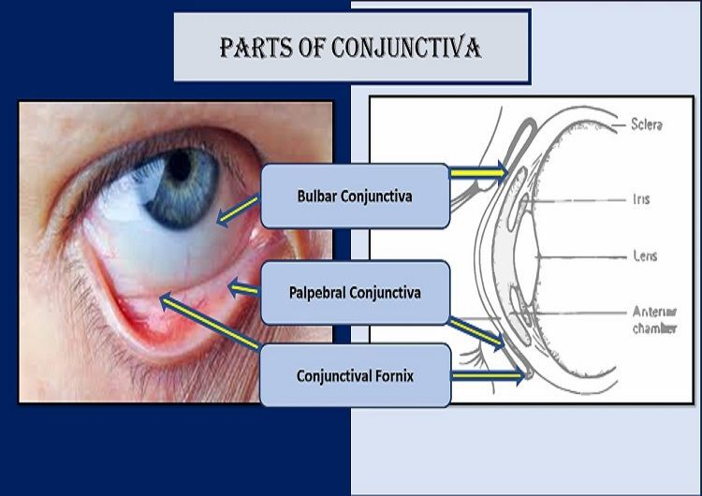

Slide 9
Staining Methods for C-MIL - Julia
Title: Immunohistochemical Profiling of Conjunctival Melanocytic Intraepithelial Lesions, Including SOX10, HMB45, Ki67, and P16
Goal: To determine how useful various immunohistochemical stains are to distinguish between low-grade & high-grade C-MIL
Findings:
H&E was used for initial diagnoses, melan-A & SOX10 were added if necessary
melan-A & SOX10 show the distribution of melanocytes more clearly, make abnormalities more apparent
Upgraded diagnosis from low-grade to high-grade C-MIL in two cases
p16 is expressed in the cytoplasm of high-grade but not low-grade C-MIL
Other stains perform similar functions to melan-A & SOX10
Clinical context & cytomorphology are both important for diagnosis
Challenges:
Building a model that considers the three staining methods in conjunction
Obtaining a significant sample size
Questions:
How does H&E staining affect diagnosis?
How does immunohistochemical staining distinguish benign lesions from C-MIL?

Slide 10
Image Classification in Cancer Research - Kayla
Title: Enhancing Anomaly Detection in Melanoma Diagnosis Through Self-Supervised Training and Lesion Comparison
Goal of the Study: To improve the performance of convolutional neural network models in comparing lesions to assist in early detection of skin melanomas.
Findings:
Through the creation of a metric (The Ugly Duck Index), they were able to quantify differences between lesions for a singular patient.
UDI takes the sum of distances from neighbors of a lesion and normalizes by k. Then this is divided by the average of these distances.
When using this approach, malignancy classification had an AUC ROC value of 0.719.
Challenges:
How to determine which k value for the KNN portion of the UDI produces the best results?
In this particularly study, k=3 yielded the best model performance and as k increases, it can decrease the success rate of the model in patients who may not have a lot of lesions.
Questions:
How can we approach the issue of model tuning with this particular project, where there is not unlimited data to train and tune on?
Will there need to be multiple models to address potential issues related to model performance and patient data availability? (i.e. model performs well with k = X, but a patient may only have Y lesions)

Slide 11
Image Classification in Cancer Research (cont) - Kayla
Title: Prostate Cancer Risk Stratification via Nondestructive 3D Pathology with Deep Learning–Assisted Gland Analysis
Goal of the Study: To analyze glands in prostate cancer in an annotation free method using image translation–assisted segmentation in 3D.
Findings:
Through the use of GAN image sequencing models, patients biopsies were converted to synthetic CK8 IF images to train a model that evaluated the risk of prostate cancer in patients.
This model, which is publicly available, had good prognostic capabilities, which could be linked to its use of 3D pathology.
Challenges:
In this particular cancer, its growth rate is relatively slow, how can this be addressed when modeling?
Questions:
How can we apply these 3D pathology techniques to our specific problem?
Is there a way we can account for growth rate, when determining high v low grade C-MIL in the model development process?

Slide 12
Paper 1: Patch-based system for Classification of Breast Histology images using deep learning - Dila
The key focus of this paper is developing an efficient and accurate computational approach to assist in the diagnosis and grading of breast cancer from histopathological images, which can have significant clinical implications.
The goal is to differentiate between normal, benign, in situ, and invasive carcinoma tissue types based on the visual features extracted from the images.
Notes:
Looking at histological images for cancer classification: there are four different categories meant for categories:
Histological images: microscopic image of tissues used in disease analysis, particularly for cancer diagnosis in the medical field

Slide 13
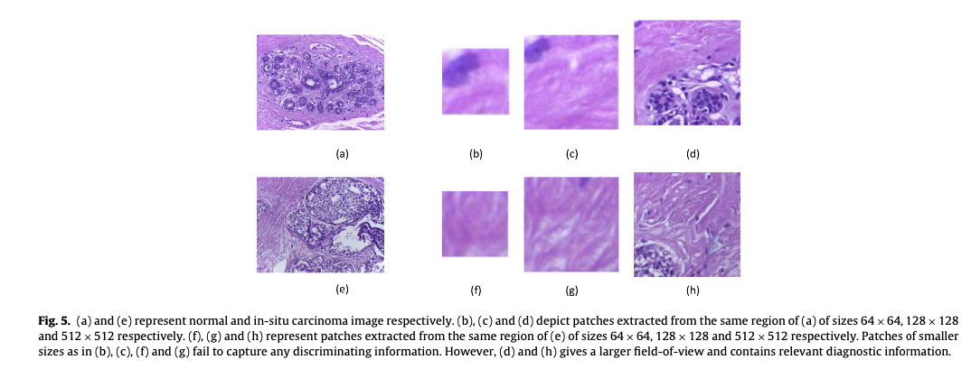
Size difference of patching and differences in pattern depiction accuracy

Slide 14
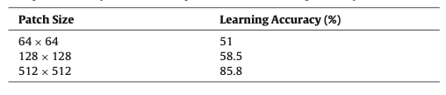
Table 2: Comparative Analysis of different patch sizes and learning accuracy
Why not 1024 x 1024? (why avoid a larger patch than 512 x 512)
‘The maximum size of non-overlapping square sized patches that can be obtained from our input image of size 2048 x 1536 is 512 x 512. Moreover, it is noted that the square sized patches of 512 x 512 were sufficient to cover the essential tissue structures in a histopathological image.’
Idea: could we develop square sized patches?
(more of this in the next paper)

Slide 15
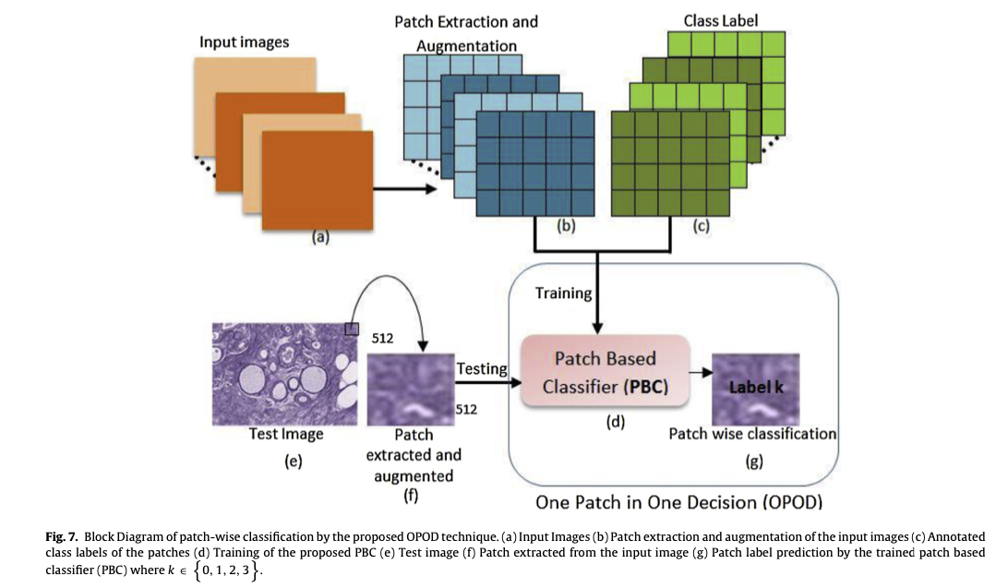
Patch-Wise Classification
Original image divided into non-overlapping patches (512 x 512)
Each patch is independently classified by neuronal networks

Slide 16
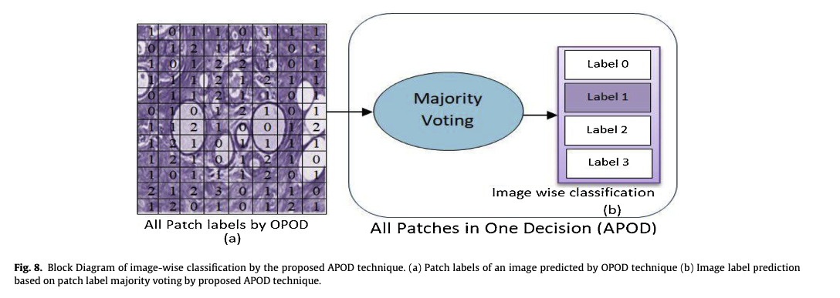
Image-Wise Classification
Image-wise
Patch labeling (same logic)
Final image class = class with maximum votes
(ex; if an image has 3 patches labeled as benign and 1 patch as normal: entire image labeled as benign)

Slide 17
Findings:
Performance improvement:
Patch-wise accuracy: 77.4% (4-class)
Image-wise accuracy: 90% (4-class)
Larger patch sizes (512 x 512) performed significantly better than the smaller one’s (64 x 64 or 128 x 128)
Key advantages:
Handles variability within an image
Reduces impact of individual misclassified patches
Provides more robust classification by considering the entire image
Smaller patches may not contain sufficient diagnostic information
Larger patches can be more computationally efficient than processing many smaller patches
Larger patches can preserve the spatial relationships and structural context

Slide 18
Final Thoughts/ Challenges
Challenges:
Limited number of training samples
Color variations in histopathological images
Complex feature extraction from medical images
Avoiding overfitting in the neural network

Slide 19
Paper 2: Melanocytic Lesions of the Conjunctiva - Dila
The key focus of this paper is developing an automated computational approach to assist in the diagnosis and grading of conjunctival melanocytic lesions, which have significant clinical implications.
The goal is to differentiate between:
Conjunctival nevus (benign)
Primary acquired melanosis (PAM) without atypia (low-grade)
Primary acquired melanosis (PAM) with atypia (high-grade)
Conjunctival melanoma (invasive malignant)
based on the visual features extracted from histopathological images.
The paper emphasizes that cytologic features (cell appearance) are more important than architectural features in predicting risk

Slide 20
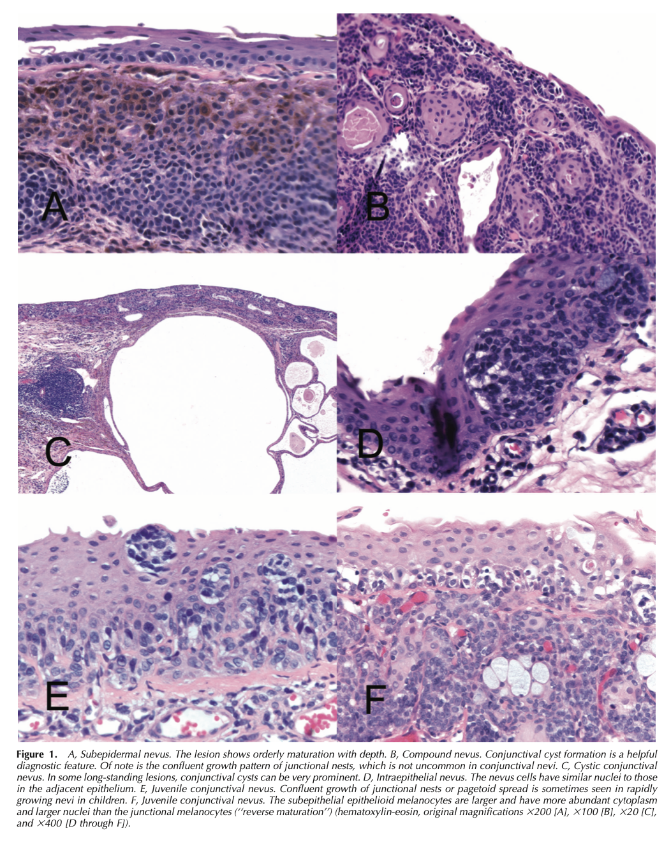
Figure 1: Conjunctival Nevus (BENIGN) Key features
Orderly maturation with depth (change in shape (smaller nuclei/ less cytoplasm) and nucleus color)
Formation of conjunctival cysts (very characteristic)
Well-circumscribed growth pattern
Similar-sized nuclei to adjacent epithelium
In juvenile cases: may show "reverse maturation" but still maintains organized structure

Slide 21
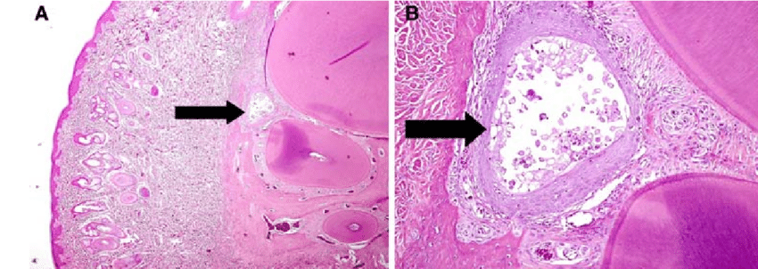
Cyst formation

Slide 22
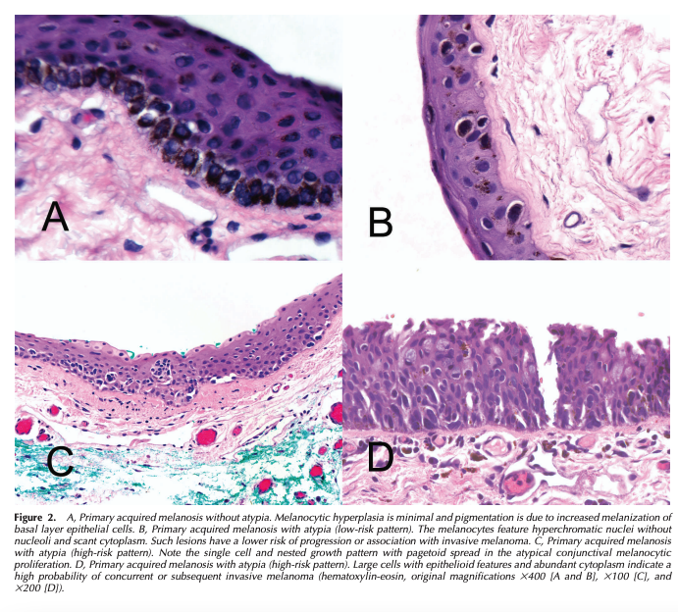
Figure 2: PAM with and without Atypia Key Features
B. LOW-RISK pattern/ low probability of progression with invasive melanoma:
Small cells
Hyperchromatic nuclei (nuclei that appear dark and stained more deeply)
Scant cytoplasm (relatively small amount of cytoplasm compares to the size of the nucleus or overall size of the cell)
C & D. HIGH-RISK pattern/ high risk probability of progression with invasive melanoma:
Large epithelioid cells (more chunky, robust)
Abundant cytoplasm
Pagetoid spread (scattered around the different levels of the epithelium)

Slide 23
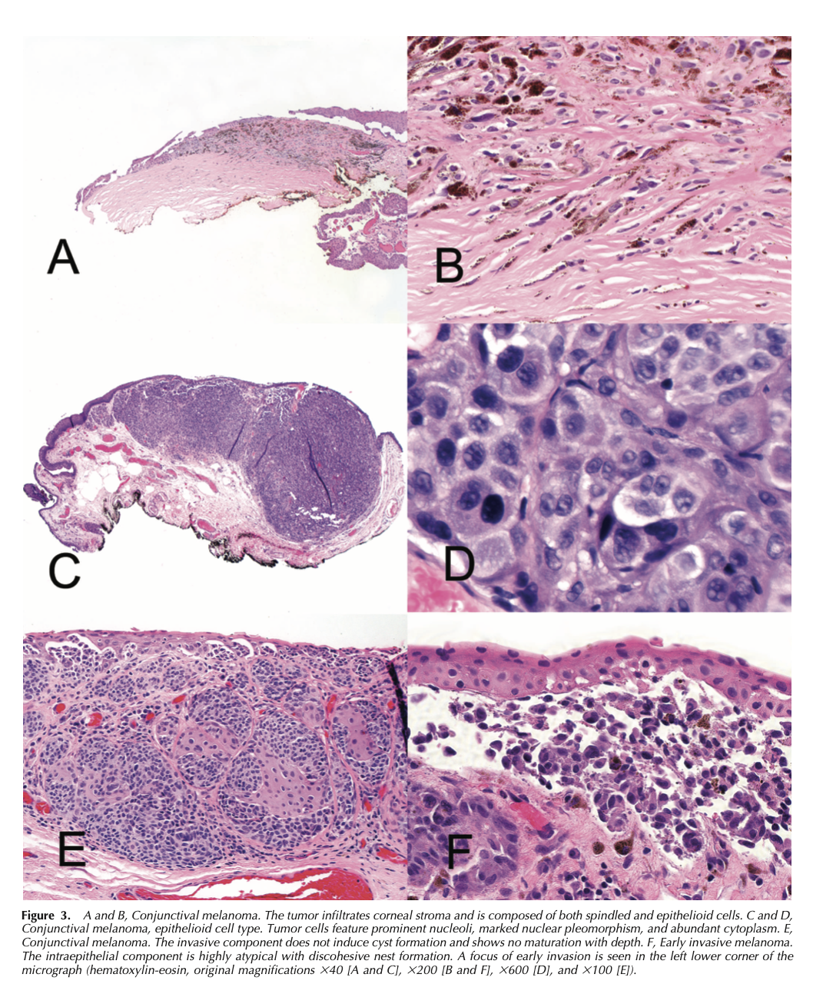
Figure 3: Conjunctival Melanoma (Invasive Malignant) Key Features
Frank invasion into deeper tissues
No maturation pattern
No cyst formation
Marked nuclear pleomorphism
The cancer is called pleomorphic because the cells grow in multiple shapes and sizes
Prominent nucleoli
Abundant abnormal cytoplasm
Discohesive growth pattern
Mixed cell populations/ contains various cell types (epithelioid and spindle)
May show invasion into cornea or deeper structures

Slide 24
 | Benign | Malignant
Cyst Formation | very distinct and organized | N/A
Cellular Organization | Cells line up neatly, clear boundaries between cell groups, regular spacing between cells, cells appear to follow a pattern | Cells appear chaotic and jumbled, no clear organization, random cell distribution, irregular clustering
Nuclear Features | Nuclei are similar in size and shape, regular round/oval appearance, even chromatin distribution, similar staining intensity | Nuclei vary dramatically in size/shape, Irregular contours, abnormal chromatin patterns, variable staining
Growth Pattern | Clear borders, stays within tissue boundaries, respects normal tissue architecture | Irregular borders, pushes into surrounding tissues, breaks through normal boundaries
Maturation | Gradual transition in cell size/shape with depth, ordered progression from top to bottom, cells become smaller/more organized deeper in tissue (Like a gradient from dark to light) | No organized transition, similar abnormal cells throughout, random cell patterns at all depths (Like a uniform chaos)

Slide 25
Critical Differentiating Features (summary) :
Cysts: Strong indicator of benign nevus
Cellular Organization: Progresses from ordered (benign) to disordered (malignant)
Nuclear Features: Progress from uniform (benign) to pleomorphic (malignant)
Growth Pattern: Confined (benign) to invasive (malignant)
Maturation: Present in benign lesions, absent in malignant ones

Slide 26
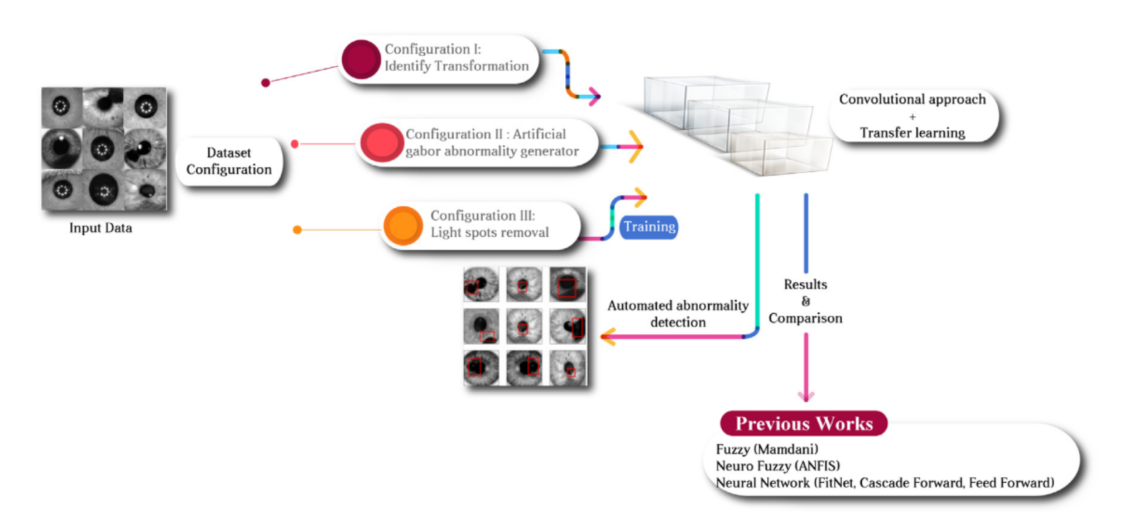
Automated Eye Cancer Classification via VCG and ResNet
Title: Towards automated eye cancer classification via VGG and ResNet networks using transfer learning
Summary
Process Flow
The author utilized CNNs combined with data augmentation to detect anomalies in eye cancer and reached 98-99% across sensitivity, precision, and accuracy
Implemented steps in remove light spots and data augmentation
Challenges
Takeaway
Limited and unbalanced training data set
The technical difficulties in handling three types of image scans
Should the size of patching be fixed or consistent?
The value of data augmentation
Prevents overfitting and improve accuracy
CNN’s and deep learning benefits over machine learning
Should we train multiple model to compare performance?

Slide 27
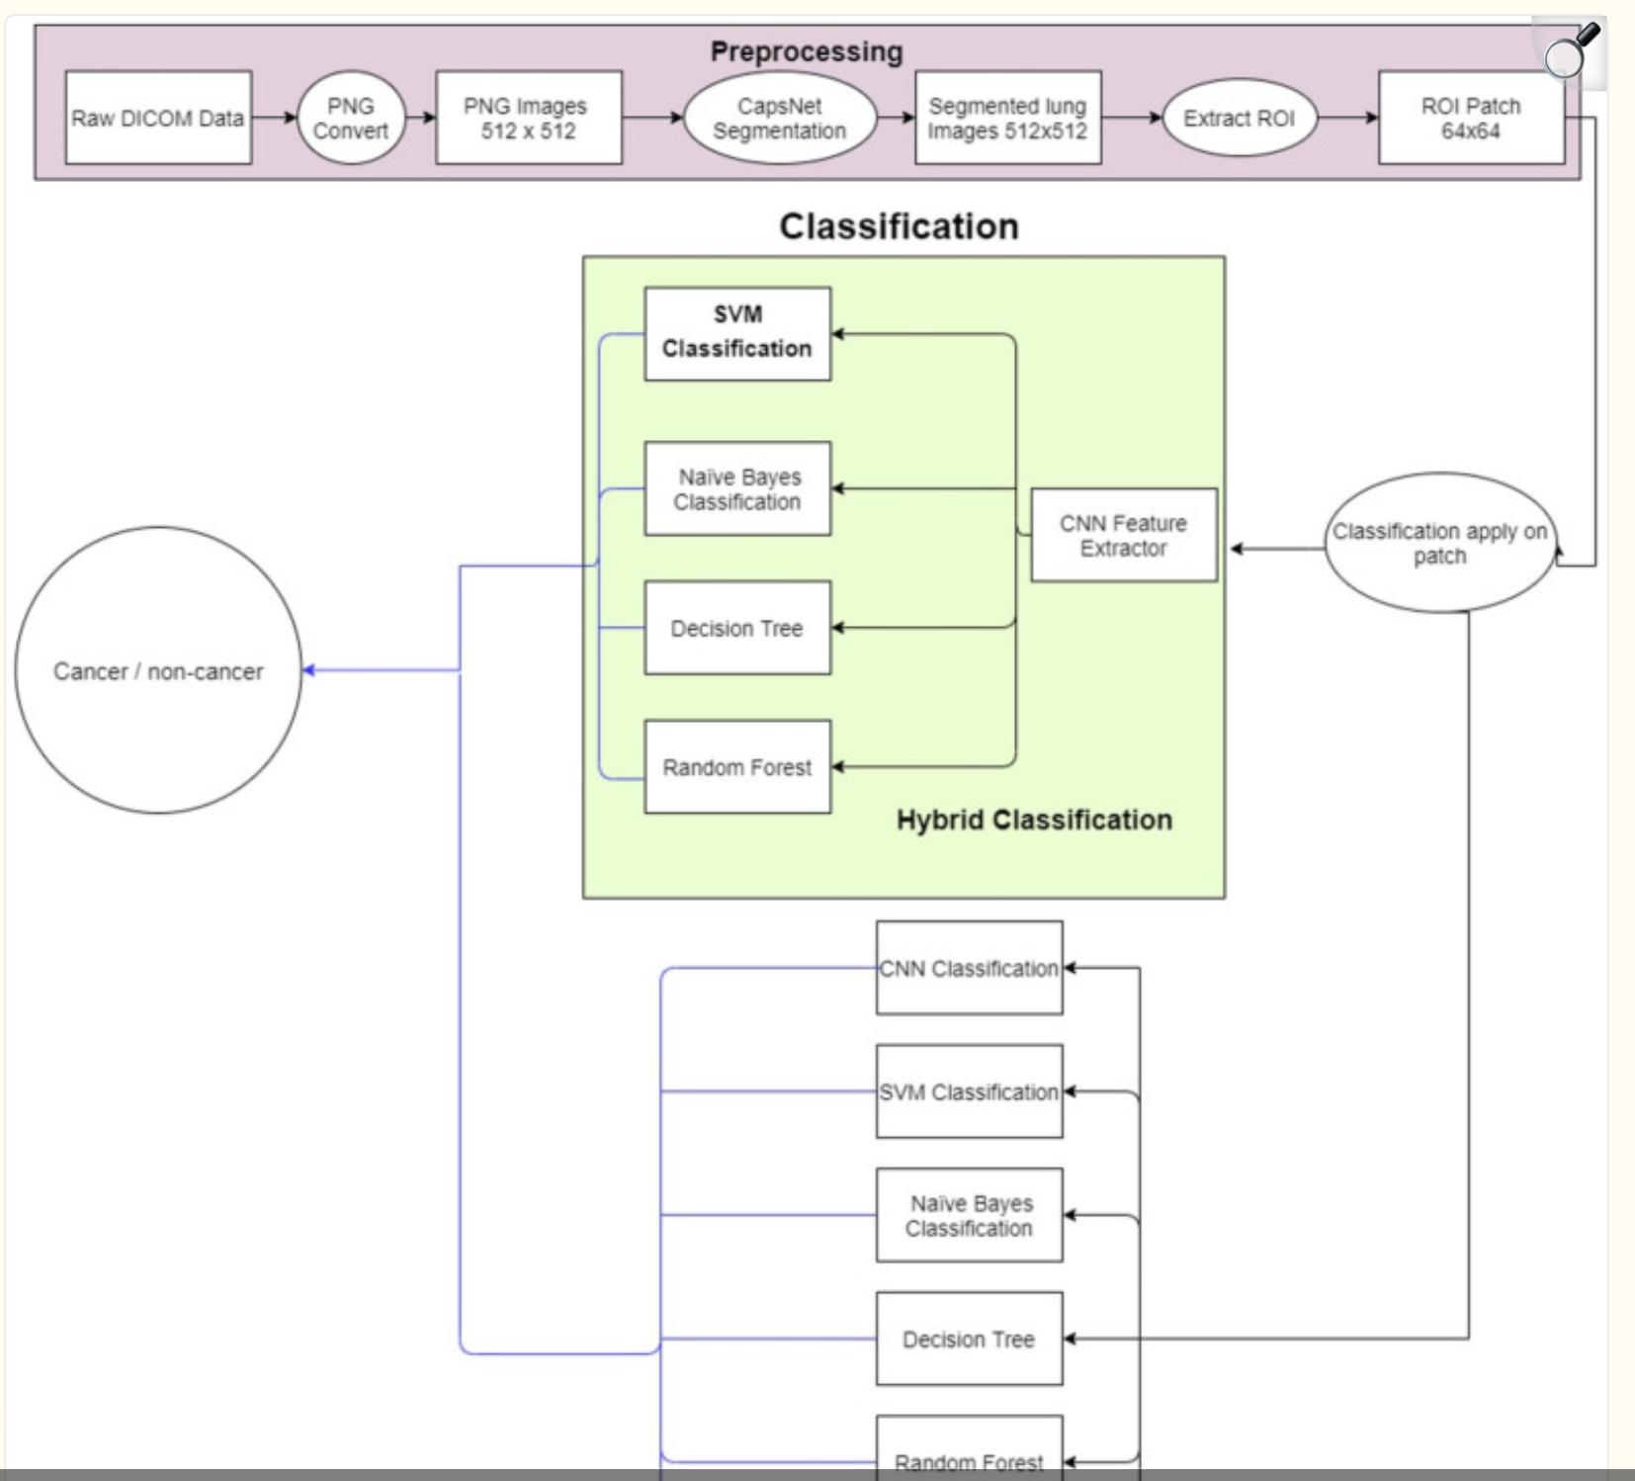
Lung Cancer Automated Diagnosis
Title: An Effective Method for Lung Cancer Diagnosis from CT Scan Using Deep Learning-Based Support Vector Network
Summary
Process Flow
Research proposed utilize SVM+CNN to automatically classify benign versus malignant lung cancer and reached a 94% accuracy rate for early lung cancer
Confirmed CNN highly dependent on imputation power and data quality and size
Challenges + Takeaway
Takeaway
Sufficient computation resources and power?
More complicated ROI and feature selection process
Potential of Hybrid Classification
The value of data augmentation
Prevents overfitting and improve accuracy
CNN’s and deep learning benefits over machine learning
Should we train multiple model to compare performance?

Slide 28
Characteristics and Risk Factor of C-MIL
Overall Eye Cancer
Race/Ethnicity: White people have a higher risk than African Americans, Hispanics, or Asian Americans.
Eye Color: Light-colored eyes are more prone to uveal melanoma than darker eyes.
Age and Sex: Risk increases with age; slightly more common in men.
Inherited Conditions:
Dysplastic nevus syndrome
Oculodermal melanocytosis increase uveal melanoma risk.
BAP1 cancer syndrome increases the risk of aggressive cancers, including uveal melanoma.
Eye moles (e.g., choroidal, giant choroidal, iris nevi) and certain skin moles (e.g., atypical nevi) increase risk.
Conjunctival Melanocytic Lesions
Challenges in Evaluation:
Rarity: Conjunctival melanocytic lesions are uncommon in
general population.
Specimen Quality: Tangential orientation or crush artifacts can limit histopathologic assessment.
Comprehensive Diagnosis: Clinical appearance, patient age, lesion location, and histopathologic features must all be considered for accurate diagnosis.
Significance of Accurate Classification:
Some conjunctival melanocytic lesions can progress to melanoma but appear clinically similar to lower-risk lesions.
Certain lesions are associated with systemic syndromes, such as:
Dysplastic nevus syndrome (familial atypical multiple mole-melanoma syndrome).
Neurofibromatosis type I.
Carney complex.

Slide 29
Works Cited
Bresler, S. C., Simon, C., Shields, C. L., McHugh, J. B., Stagner, A. M., & Patel, R. M. (2022, May). Conjunctival Melanocytic Lesions. Archives of Pathology and Laboratory Medicine, 146(5), 632-646. https://doi.org/10.5858/arpa.2021-0006-RA.
Collenne, J., Iguernaissi, R., Dubuisson, S., & Merad, D. (2023, October). Enhancing anomaly detection in Melanoma diagnosis through Self-Supervised Training and lesion comparison. In International Workshop on Machine Learning in Medical Imaging (pp. 155-163). Cham: Springer Nature Switzerland.
Milman, T., Eiger-Moscovich, M., Henry, R. K., Folberg, R., Coupland, S. E., Grossniklaus, H. E., Mudhar, H. S., Eberhart, C. G., Heegaard, S., Auw-Hädrich, C., Herwig-Carl, M. C., Löffler, K. U., Cherepanoff, S., Zhang, Q., Sharpe, J. E., Rose O See , T., Shields, C. L., & Eagle Jr, R. C. (2020, October 30). Validation of the newly proposed World Health Organization Classification system for conjunctival melanocytic intraepithelial lesions: A comparison with the C-min and Pam Classification Schemes. American journal of ophthalmology. https://pubmed.ncbi.nlm.nih.gov/33130046/
Milman, T., Zhang, Q., Ang, S., Elder, D., Lally, S. E., Shields, J. A., Hamershock, R. A., Sioufi, K., Shields, C. L., & Eagle, R. C., Jr (2021). Immunohistochemical Profiling of Conjunctival Melanocytic Intraepithelial Lesions, Including SOX10, HMB45, Ki67, and P16. American journal of ophthalmology, 222, 148–156. https://doi.org/10.1016/j.ajo.2020.09.033.
Mudhar, H. S., Krishna, Y., Cross, S., Auw-Haedrich, C., Barnhill, R., Cherepanoff, S., Eagle, R., Farmer, J., Folberg, R., Grossniklaus, H., Herwig-Carl , M. C., Hyrcza, M., Lassalle , S., Loeffler, K. U., Moulin, A., Milman, T., Verdijk , R. M., Heegaard , S., & Coupland, S. E. (2023, November 3). A multicenter study validates the WHO 2022 classification for conjunctival melanocytic intraepithelial lesions with clinical and prognostic relevance. Laboratory Investigation. https://www.sciencedirect.com/science/article/pii/S0023683723002246#:~:text=Briefly%2C%20the%204%2Dtiered%20scoring,C%2DMIL%2C%20including%20MIS
Xie, W., Reder, N. P., Koyuncu, C., Leo, P., Hawley, S., Huang, H., ... & Liu, J. T. (2022). Prostate cancer risk stratification via nondestructive 3D pathology with deep learning–assisted gland analysis. Cancer research, 82(2), 334-345.
Risk factors for eye cancer | Ocular melanoma risk. (n.d.). American Cancer Society. https://www.cancer.org/cancer/types/eye-cancer/causes-risks-prevention/risk-factors.html
Whittington, Carli. Bresler, Scott. Simon, Caroline. (2024, Jan). Melanocytic lesions of the conjunctiva: an up-to-date review. Diagnostic Histopathology, 30(1), pp37-59, https://www.diagnostichistopathology.co.uk/article/S1756-2317(23)00165-2/fulltext
Shafi, I., Din, S., Khan, A., Díez, I. T., Casanova, R. D. J. P., Pifarre, K. T., & Ashraf, I. (2022, Nov). An Effective Method for Lung Cancer Diagnosis from CT Scan Using Deep Learning-Based Support Vector Network. Cancers, 14(21), 5457. https://doi.org/10.3390/cancers14215457
Santos-Bustos,

Slide 30
Works Cited (continued)
Santos-Bustos, Nguyen Binh. Espitia, Helbert(2022, Nov). Towards automated eye cancer classification via VGG and ResNet networks using transfer learning. Engineering Science and Technology. vol(35). https://doi.org/10.1016/j.jestch.2022.101214
Whittington, C. P., Bresler, S. C., Simon, C., Patel, R. M., & Shields, C. L. (2023, November 6). Melanocytic lesions of the conjunctiva: An up-to-date review. Diagnostic Histopathology. https://www.sciencedirect.com/science/article/abs/pii/S1756231723001652
Kaushiki Roy, Debapriya Banik, Debotosh Bhattacharjee, Mita Nasipuri, Patch-based system for Classification of Breast Histology images using deep learning, Computerized Medical Imaging and Graphics, Volume 71,2019, Pages 90-103, ISSN 0895-6111, https://doi.org/10.1016/j.compmedimag.2018.11.003.
Zembowicz A, Mandal RV, Choopong P. Melanocytic lesions of the conjunctiva. Arch Pathol Lab Med. 2010 Dec;134(12):1785-92. doi: 10.5858/2009-0522-RAR.1. PMID: 21128776.

